Slide 1
Obstacles avoiding Robot

Slide 2
Problem
In this modern world vehicles became most inevitable component in a family without vehicles there is no transportation. From children to old people every one are using motorcycles or any vehicle for their transportation. But there is less safety infact no safety in these vehicles.

Slide 3
We want change this case because almost 1.5 million people are dying or facing accidents and becoming disabled.So we came up with a solution that is obstacle avoiding robot.
This robot goes forward until it finds something in its way. Once it finds something in its way then it looks 180 degrees all around it and then chooses the path which suits best.

Slide 4
Requirements
Arduino UNO board
Motor Shield
Ultrasonic Sensor
Two switches
Power cable and HW battery
Two DC meters and one ball bearing

Slide 5
Advantages
Then what are the advantages of this robot :
1.This increases safety while driving when embedded in a vehicle.
2.Also increases safety in construction sites when embedded in something like a suit that would be used by an engineer.
3.Not only about safety if it is developed more it can be used in smart or auto driving.

Slide 6
A brief note about code
At first when the robot is booted the code gets started and when this happens we’ve numbered the pins and inputs would go through these numbered const variables .
In this ultrasonic sensor to start or to trigger we shall send one analog signal we called it as trig and when we’re receiving the signal back we called it as echo.
If we send ‘high’ to a motor then it runs and ‘low’ signal says the motor to stop.

Slide 7
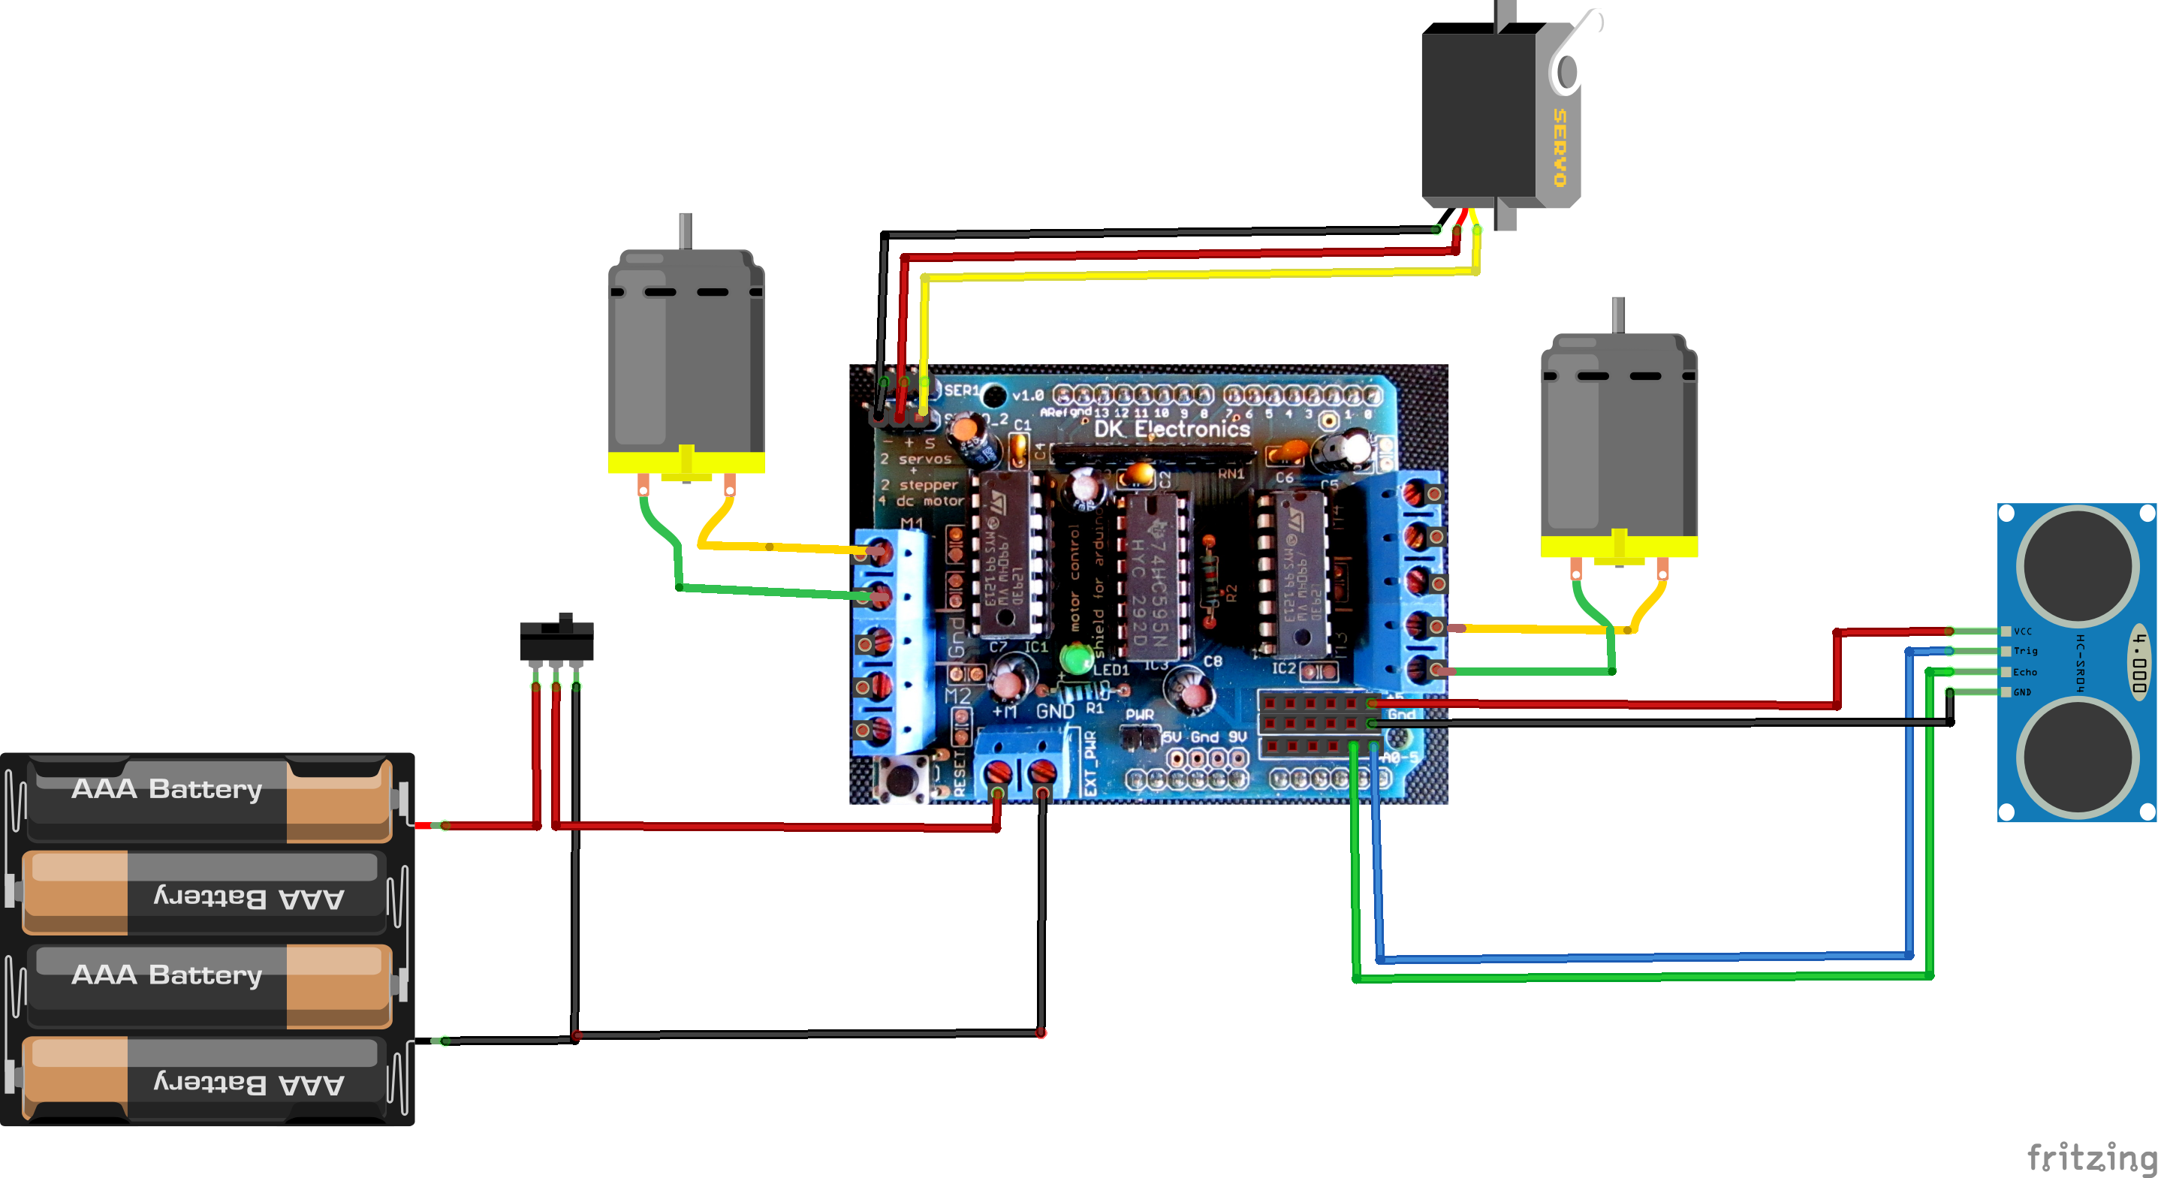
Circuit Diagram

Slide 8
Code
#include <Servo.h> //Servo motor library. This is standard library
#include <NewPing.h> //Ultrasonic sensor function library. You must install this library
//our L298N control pins
const int LeftMotorForward = 7;
const int LeftMotorBackward = 6;
const int RightMotorForward = 4;
const int RightMotorBackward = 5;
//sensor pins
#define trig_pin A1 //analog input 1
#define echo_pin A2 //analog input 2
#define maximum_distance 200
boolean goesForward = false;
int distance = 100;
NewPing sonar(trig_pin, echo_pin, maximum_distance); //sensor function
Servo servo_motor; //our servo name
void setup(){
pinMode(RightMotorForward, OUTPUT);
pinMode(LeftMotorForward, OUTPUT);
pinMode(LeftMotorBackward, OUTPUT);
pinMode(RightMotorBackward, OUTPUT);
servo_motor.attach(10); //our servo pin

Slide 9
servo_motor.write(115);
delay(2000);
distance = readPing();
delay(100);
distance = readPing();
delay(100);
distance = readPing();
delay(100);
distance = readPing();
delay(100);
}
void loop(){
int distanceRight = 0;
int distanceLeft = 0;
delay(50);
if (distance <= 20){
moveStop();
delay(300);
moveBackward();
delay(400);
moveStop();
delay(300);
distanceRight = lookRight();
delay(300);
distanceLeft = lookLeft();
delay(300);

Slide 10
if (distance >= distanceLeft){
turnRight();
moveStop();
}
else{
turnLeft();
moveStop();
}
}
else{
moveForward();
}
distance = readPing();
}
int lookRight(){
servo_motor.write(50);
delay(500);
int distance = readPing();
delay(100);
servo_motor.write(115);
return distance;
}
int lookLeft(){
servo_motor.write(170);
delay(500);
int distance = readPing();

Slide 11
delay(100);
servo_motor.write(115);
return distance;
delay(100);
}
int readPing(){
delay(70);
int cm = sonar.ping_cm();
if (cm==0){
cm=250;
}
return cm;
}
void moveStop(){
digitalWrite(RightMotorForward, LOW);
digitalWrite(LeftMotorForward, LOW);
digitalWrite(RightMotorBackward, LOW);
digitalWrite(LeftMotorBackward, LOW);
}
void moveForward(){
if(!goesForward){
goesForward=true;

Slide 12
digitalWrite(LeftMotorForward, HIGH);
digitalWrite(RightMotorForward, HIGH);
digitalWrite(LeftMotorBackward, LOW);
digitalWrite(RightMotorBackward, LOW);
}
}
void moveBackward(){
goesForward=false;
digitalWrite(LeftMotorBackward, HIGH);
digitalWrite(RightMotorBackward, HIGH);
digitalWrite(LeftMotorForward, LOW);
digitalWrite(RightMotorForward, LOW);
}
void turnRight(){
digitalWrite(LeftMotorForward, HIGH);
digitalWrite(RightMotorBackward, HIGH);

Slide 13
digitalWrite(LeftMotorBackward, LOW);
digitalWrite(RightMotorForward, LOW);
delay(500);
digitalWrite(LeftMotorForward, HIGH);
digitalWrite(RightMotorForward, HIGH);
digitalWrite(LeftMotorBackward, LOW);
digitalWrite(RightMotorBackward, LOW);
}
void turnLeft(){
digitalWrite(LeftMotorBackward, HIGH);
digitalWrite(RightMotorForward, HIGH);
digitalWrite(LeftMotorForward, LOW);
digitalWrite(RightMotorBackward, LOW);
delay(500);
digitalWrite(LeftMotorForward, HIGH);
digitalWrite(RightMotorForward, HIGH);
digitalWrite(LeftMotorBackward, LOW);
digitalWrite(RightMotorBackward, LOW);
}

Slide 14
Conclusion
This robot is a efficient one to dealt with accidents in traffic, constructions etc.

